Slide 1
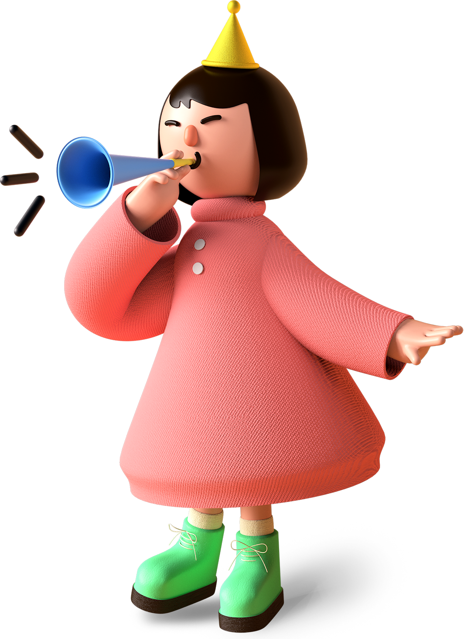
Materi Introduction Kelas 10 (Speaking)
Talking About Self
and Family
duobahasa.com

Slide 2
Pengertian Talking About Self
Talking about self means to tell people some basic information about yourself, like:
Your name
Where you're from
Your favorite subjects
Your hobbies
etc.
duobahasa.com

Slide 3
Pengertian Talking About Family
Talking about family means to tell people some basic information about your family, like:
Your parent's name
Your parent's job
Your brother's or sister's name
Your brother's or sister's job
etc.
duobahasa.com

Slide 4
Contoh Kalimat Talking About Self
Berikut contoh frasa (phrase) sekaligus contoh kalimat Introduction: Talking About Self:
Hello. Let me introduce myself, my name is Marshall D. Teach.
Hi. I’m Marshall.
I’d like to introduce myself, I’m Marshall.
Pleased to meet you, I’m Marshall.
Nice to meet you, I’m Marshall.
duobahasa.com

Slide 5
Contoh Kalimat Talking About Others (family and othe people)
Berikut contoh frasa (phrase) sekaligus contoh kalimat Talking About Family:
My father is an English Teacher.
I have two brothers, they are Ace and Sabo.
My mother is a housewife.
I would like you to meet Usop.
Hi Gendis, this is Yati. Hi Yati, this is Gendis.
duobahasa.com

Slide 6
Contoh text Talking About Self and Family
My name is Gendis. I have two sisters. They are Ayu and Putri. Ayu is older than Putri and Ayu is younger than me. My father’s name is Hartono. He works as a manager. My mother’s name is Wati. She is a housewife. My favorite subjects are Math, English, and Computer. I have my hobbies, they are playing football, writing on a blog, etc. I love my country very much because it has the best people, me, and my family.
duobahasa.com

Slide 7
Video Materi Talking About Self and Others
duobahasa.com

Slide 8
Terima kasih
duobahasa.com

